Slide 1
WEBWARRIORS
PRESENTS

Slide 2

SEYONI
SERVE MADE SIMPLE
A COMPREHENSIVE SMART WORKERS MANAGEMENT SYSTEM
AHZEM
DILINI
DEWINDI
SHALAKA
ANJAD

Slide 3



MEET OUR TEAM
AHZEM
DILINI
DEWINDI
SHALAKA
AMJAD

Slide 4
01
Problem Definition
02
Background and Motivation
CONTENT
03
Project Aim and Objectives
04
User Roles
05
Features and Functionalities
06
Technology Stack
07
End
SEYONI
SERVE MADE SIMPLE
01.
SECURITY
Surge in inappropriate behavior, robberies, murders, and threats during home service appointments.
02.
VERIFICATION
Lack of identity verification and accountability mechanisms in traditional hiring methods.
03.
RECOGNIZATION
Urgent need for a secure system connecting customers with verified providers to ensure safety and transparency in service delivery.

Slide 5

PROBLEM DEFINITION
01.
02.
03.
Increasing reliance on home services due to changing lifestyles and urbanization.
Growing concerns about safety and security in traditional service hiring practices.
SECURITY
VERIFICATION
RECOGNIZATION
Surge in inappropriate behavior, robberies, murders, and threats during home service appointments.
Lack of identity verification and accountability mechanisms in traditional hiring methods.
Urgent need for a secure system connecting customers with verified providers to ensure safety and transparency in service delivery.
Opportunity to enhance efficiency and convenience for both customers and service providers through technological solutions.
Rise of digital platforms in other industries, highlighting the need for innovation in home services.
SEYONI
SERVE MADE SIMPLE

Slide 6


01.
SECURITY
02.
Surge in inappropriate behavior, robberies, murders, and threats during home service appointments.
VERIFICATION
03.
Lack of identity verification and accountability mechanisms in traditional hiring methods.
RECOGNIZATION
Urgent need for a secure system connecting customers with verified providers to ensure safety and transparency in service delivery.
BACKGROUND & MOTIVATION
To develop a synergistic platform for multifaceted service provision through innovative digitization and advanced IT enablement, with an unwavering focus on reliability and accountability.
Increasing reliance on home services due to changing lifestyles and urbanization.
Growing concerns about safety and security in traditional service hiring practices.
Opportunity to enhance efficiency and convenience for both customers and service providers through technological solutions.
Rise of digital platforms in other industries, highlighting the need for innovation in home services.

Slide 7

AIM
To develop a synergistic platform for multifaceted service provision through innovative digitization and advanced IT enablement, with an unwavering focus on reliability and accountability.
Increasing reliance on home services due to changing lifestyles and urbanization.
Growing concerns about safety and security in traditional service hiring practices.
Opportunity to enhance efficiency and convenience for both customers and service providers through technological solutions.
Rise of digital platforms in other industries, highlighting the need for innovation in home services.
Provide a convenient and reliable method for users to find and hire verified service providers.
Boost transparency and fortify security by integrating GPS tracking into service transactions.
Improve safety for both service seekers and providers with an emergency assistance feature.
Creating user-friendly UI designs to enhance the user experience.

Slide 8








OBJECTIVES
Provide a convenient and reliable method for users to find and hire verified service providers.
Boost transparency and fortify security by integrating GPS tracking into service transactions.
To develop a synergistic platform for multifaceted service provision through innovative digitization and advanced IT enablement, with an unwavering focus on reliability and accountability.
Improve safety for both service seekers and providers with an emergency assistance feature.
Creating user-friendly UI designs to enhance the user experience.
Borcelle
Verify Email
Review & Approve
ADMIN
SERVICE SEEKER
SERVICE PROVIDER
Plumbing Service
Painting
House Cleaning
Gardening & Landscaping
Appliance Repair Service
Pest Control Services
Security Camera Service
Rating & Payment

Slide 9


Provide a convenient and reliable method for users to find and hire verified service providers.
Improve safety for both service seekers and providers with an emergency assistance feature.
Boost transparency and fortify security by integrating GPS tracking into service transactions.
Creating user-friendly UI designs to enhance the user experience.
USER ROLES
Verify Email
Review & Approve
ADMIN
SERVICE SEEKER
SERVICE PROVIDER
Plumbing Service
Painting
House Cleaning
Gardening & Landscaping
Appliance Repair Service
Pest Control Services
Security Camera Service
Rating & Payment
Emergency Assistance
Service Provider Profile Creation & Verification
Rating and Review System
Real-time Tracking of Service Providers
Service Request Management
User Registration & Profile Management
Secure Payment Integration

Slide 10


FEATURES & FUNCTIONALITIES
Service Provider Profile Creation & Verification
Rating and Review System
Real-time Tracking of Service Providers
Service Request Management
User Registration & Profile Management
Secure Payment Integration
Emergency Assistance
THANK YOU

Slide 11
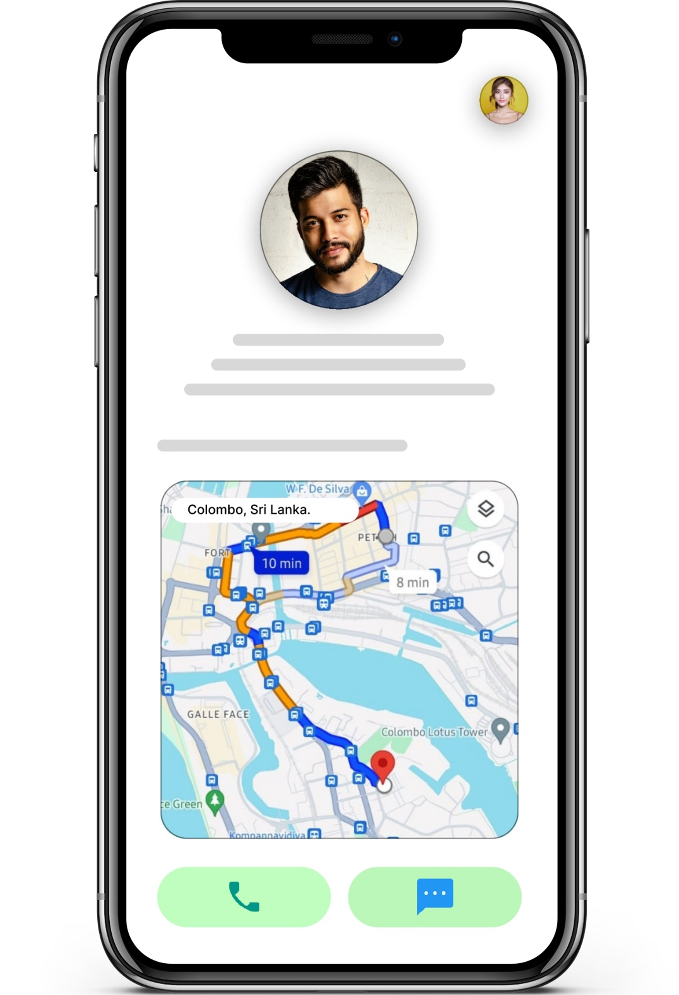
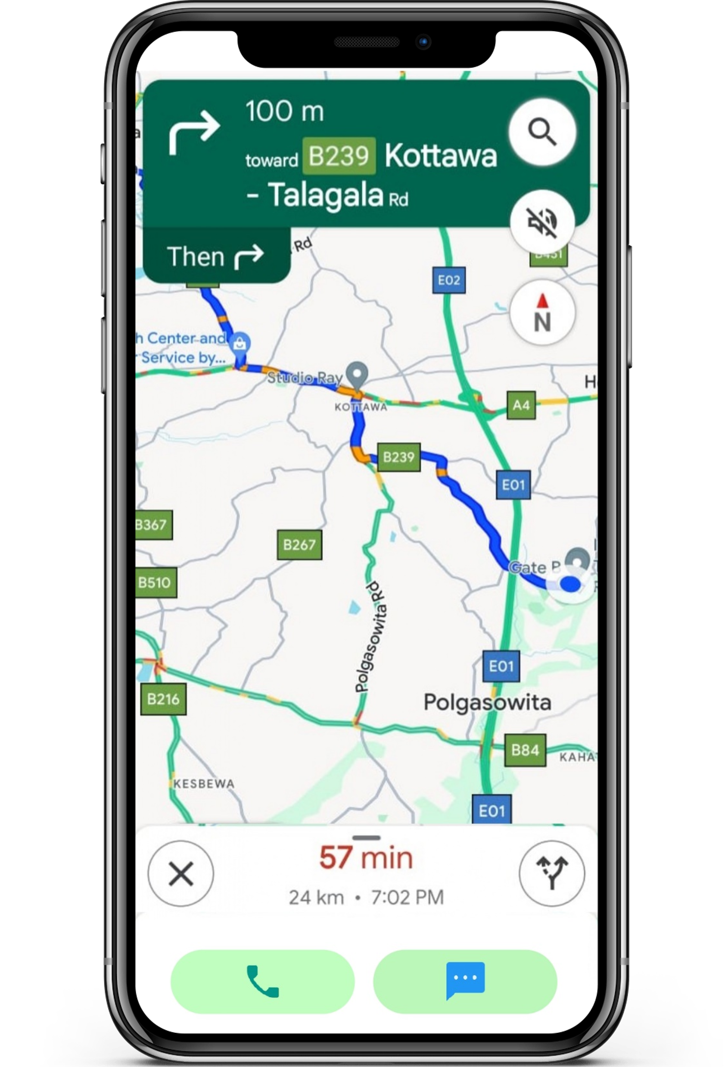
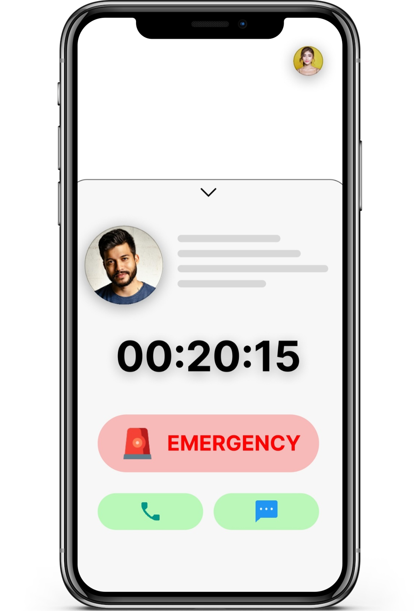
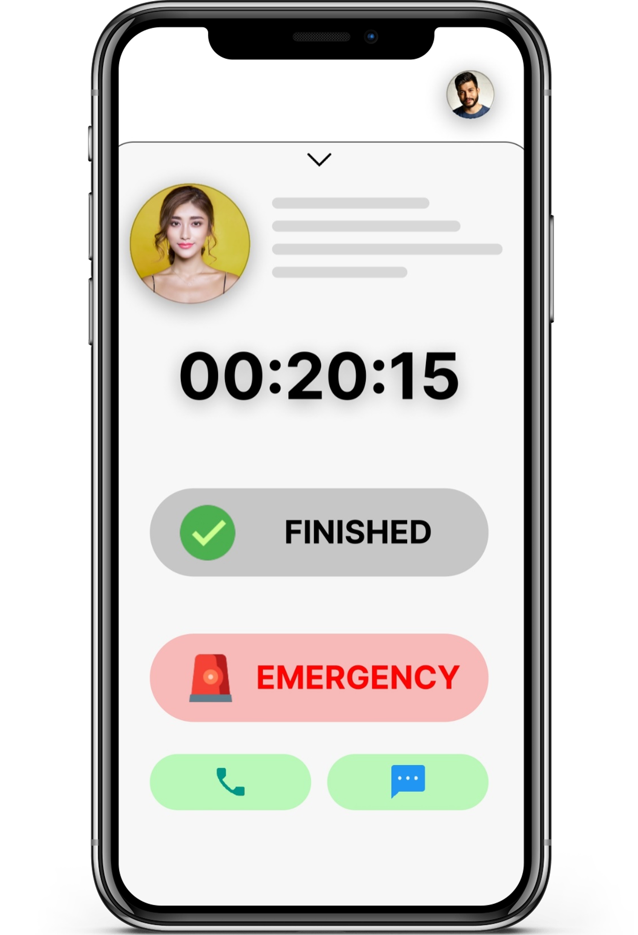
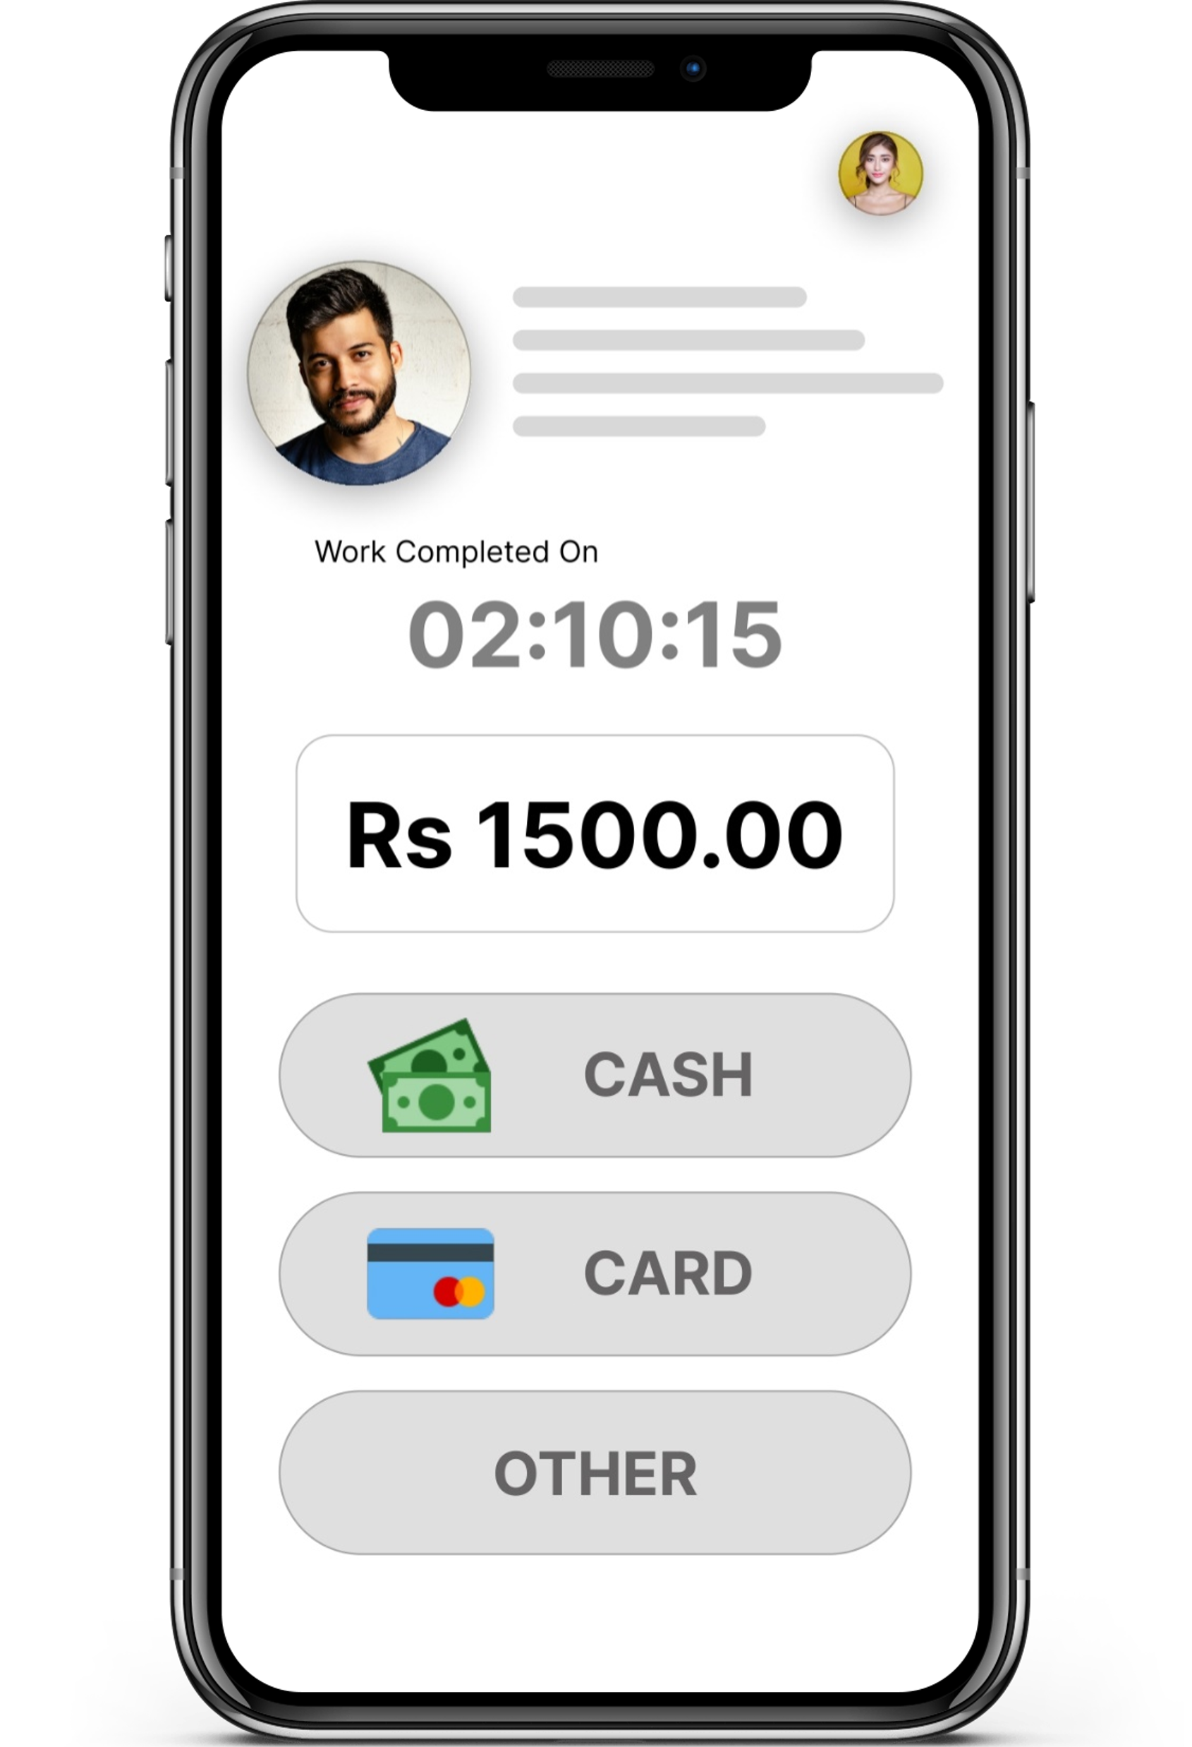
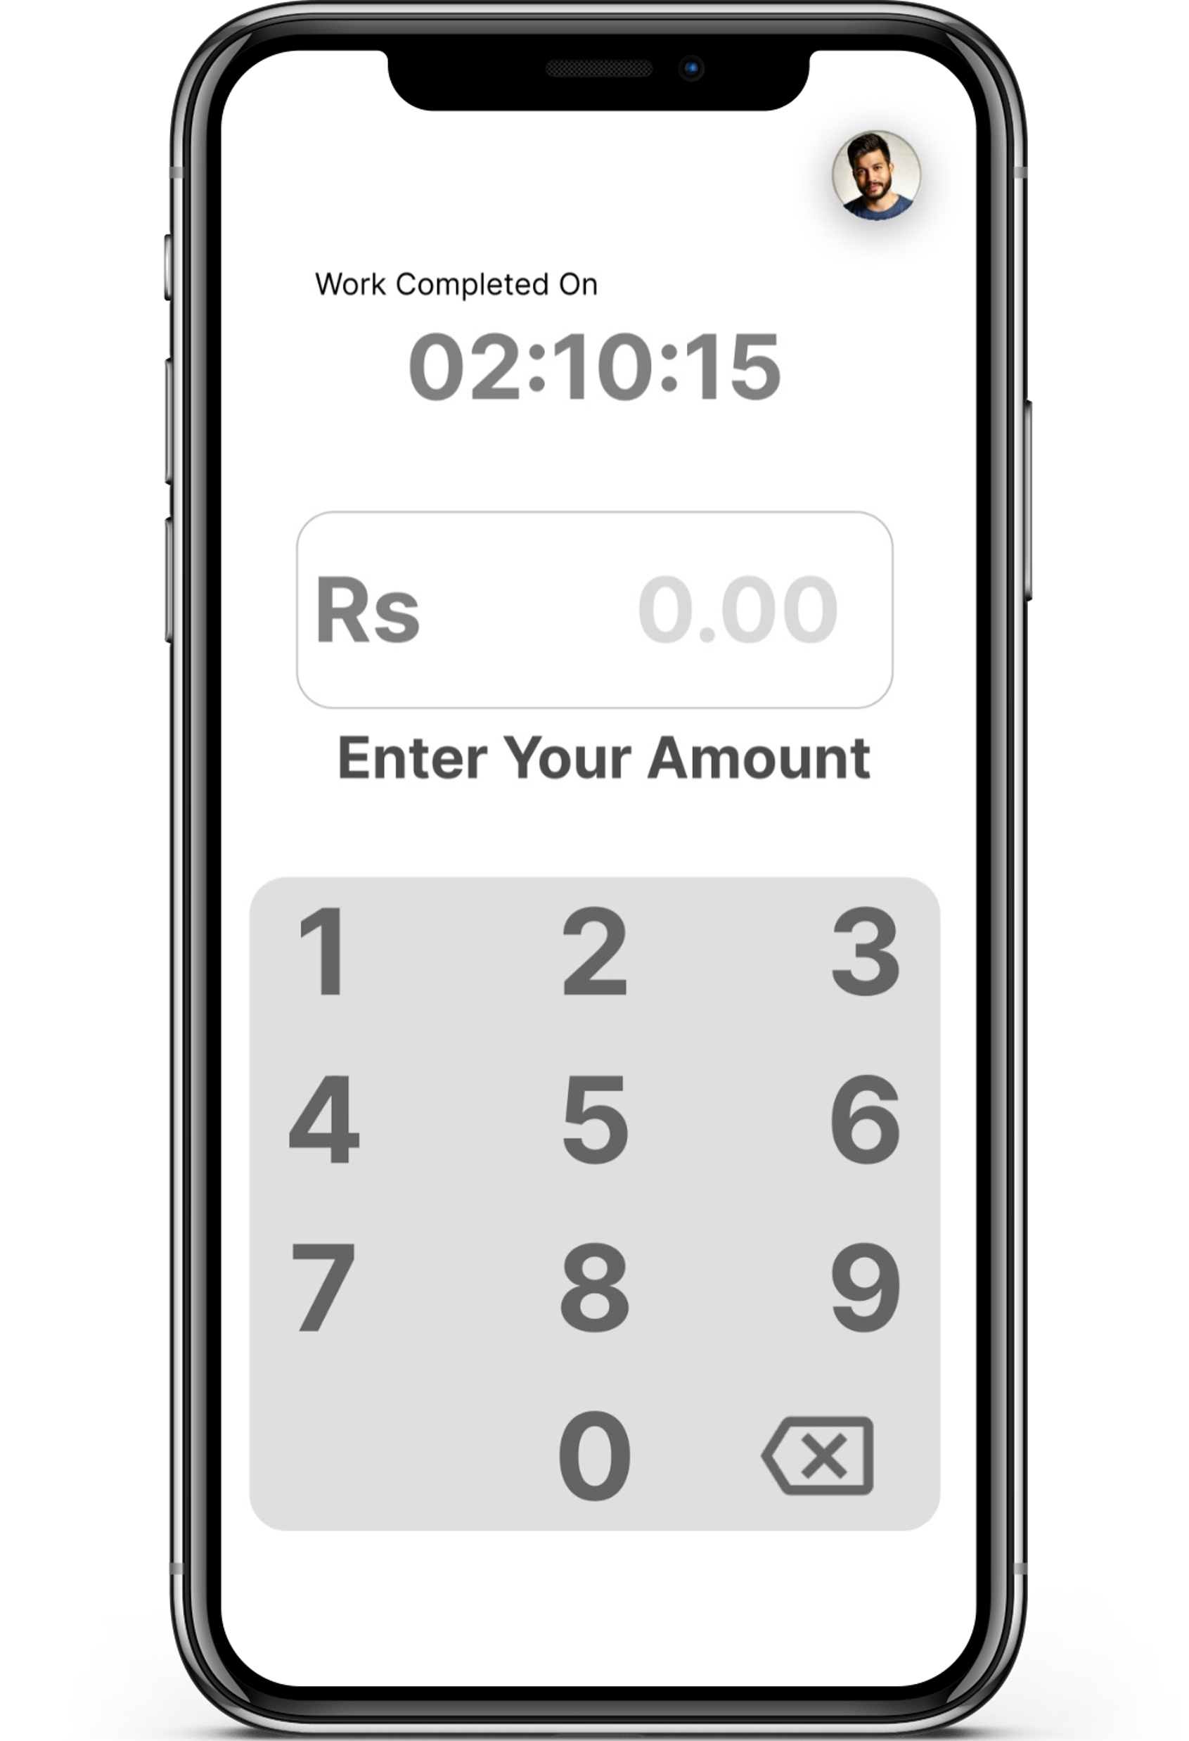
Service Provider Profile Creation & Verification
Service Request Management
Rating and Review System
User Registration & Profile Management
Real-time Tracking of Service Providers
Secure Payment Integration
FUNCTIONALITIES
Emergency Assistance
MOTIVATION
SERVICE SEEKER
SERVICE PROVIDER
Pressing need to address safety concerns in home service appointments.
Enhance trust among users and increase utilization of home services for economic growth.
Aim to mitigate risks of unauthorized access and fraudulent activities.

Slide 12
Emergency Assistance
SERVICE SEEKER
SERVICE PROVIDER

Slide 13







Emergency Assistance
SERVICE SEEKER
SERVICE PROVIDER
MONGO DB
PAYMENT GATEWAY
EXPRESS JS
GOOGLE MAPS API
NODE JS
FLUTTER
REACT JS

Slide 14


Emergency Assistance
TECHNOLOGY STACK
MONGO DB
PAYMENT GATEWAY
EXPRESS JS
GOOGLE MAPS API
NODE JS
FLUTTER
REACT JS
THANK YOU

Slide 15


Emergency Assistance
MONGO DB
PAYMENT GATEWAY
EXPRESS JS
GOOGLE MAPS API
THANK YOU
NODE JS
NOW WE ARE OPEN FOR THE DISCUSSION
FLUTTER
REACT JS

